Slide 1



Forcasting_Cryprocurrency_Using_ML and ARIMA
View in Power BI
Last data refresh:
11/4/2021 12:14:29 AM UTC
Downloaded at:
12/20/2021 10:59:50 PM UTC

Slide 2
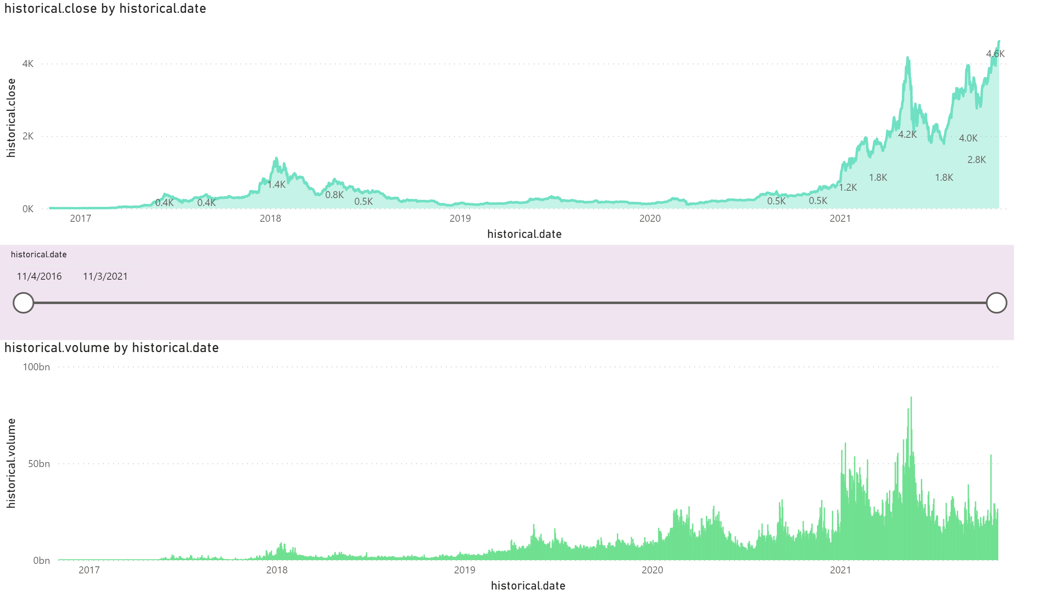
Page 1
Notes:
stackedAreaChart
No alt text provided
clusteredColumnChart
No alt text provided
slicer
No alt text provided

Slide 3
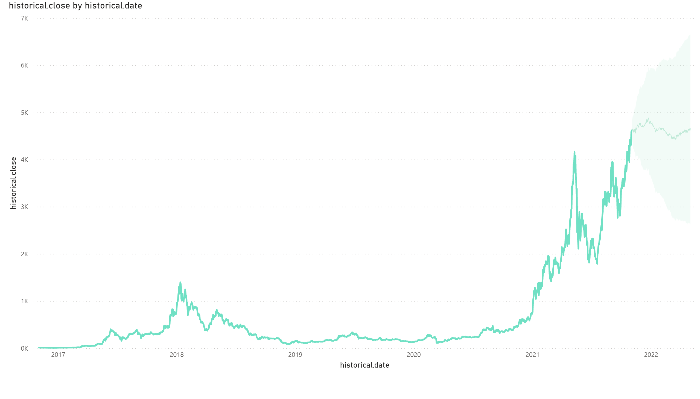
Page 2
Notes:
lineChart
No alt text provided

Slide 4
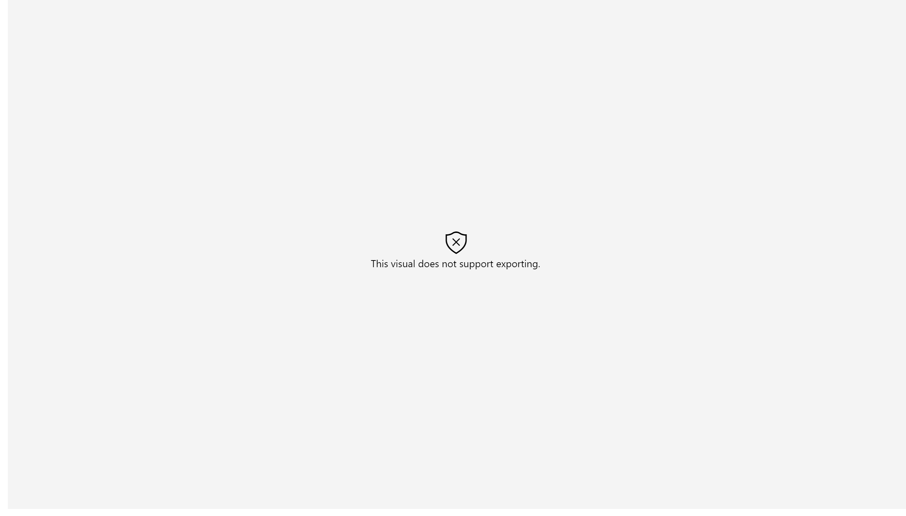
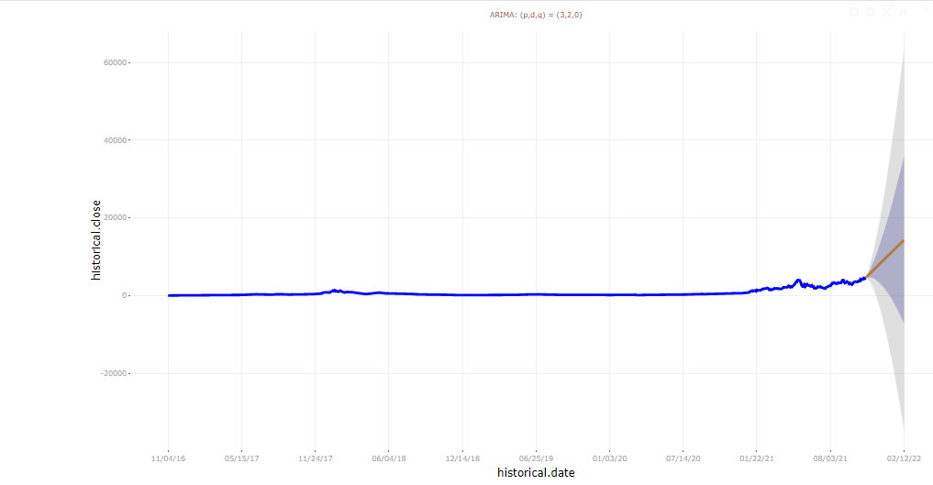
Page 4
Notes:
forecastTools93EB212B02C44467B120F2563F68A7F6
No alt text provided

Slide 5
